Slide 1
Self-supervised Contrastive Enhancement with Symmetric Few-shot Learning Towers for Cold-start News Recommendation
task
Source : CIKM ‘23
Speaker : yang-YI, LIN
Advisor : Jia-Ling, Koh
Date : 2024/03/12

Slide 2
Outline
Introduction
Method
Experiment
Conclusion

Slide 3
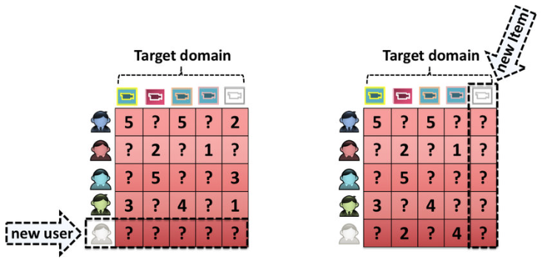
Cold-Start Problem

Slide 4
Enhance representation with Auxiliary Information
user attributes
User representation

Slide 5
Outline
Introduction
Method
Experiment
Conclusion

Slide 6
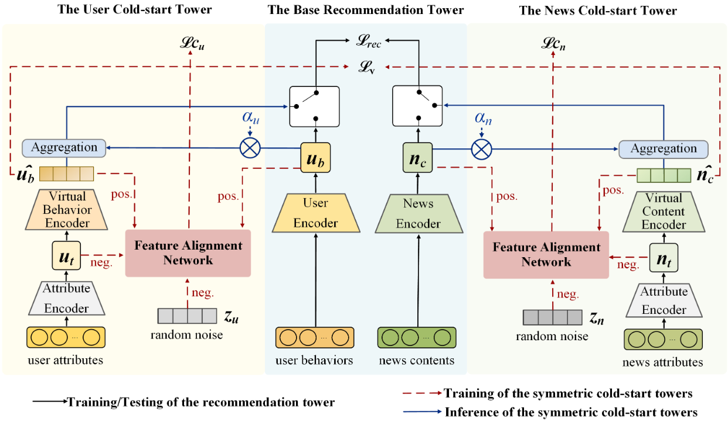
Symmetric Few-shot Learning framework for Cold-start News Recommendation (SFCNR)

Slide 7
Symmetric Few-shot Learning framework for Cold-start News Recommendation (SFCNR)

Slide 8
Definition of Warm/Cold Users and News
𝑢 = $\{{\text{A}}_{u}, B, {flag}_{u}\}$ A：attribute features B：behavior features
𝑛 = $\{A_{n}, C, U_{n}, {flag}_{n}\}$ C：content features U：users who have clicked
$flag：$ used in the gating mechanism
warm
normal
cold

Slide 9
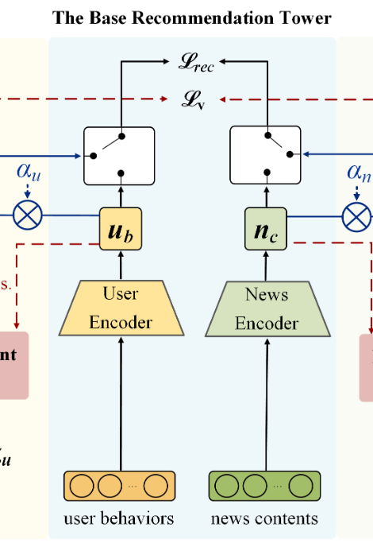
Basic Recommendation Tower
generate representations of user behaviors and news contents
cold users or news
→ enhance with virtual information

Slide 10
Basic Training
probability scores $y$ ($y=un^{T}$)
positive sample：clicked news
negative samples：randomly selected not clicked
loss function

Slide 11
Personalized Gating Mechanism
fused original feature representation ($u_{b}$) and the virtual feature representation( ${\hat{u}}_{b}$)
$q^{T}, W_{u}, b_{u}$：trainable parameters
The news will be fused in the same way.

Slide 12
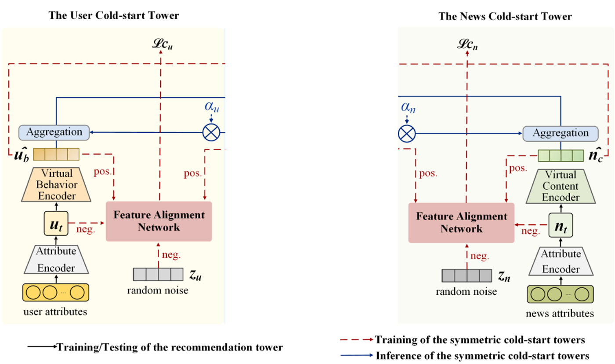
Symmetric Few-shot Learning Towers

Slide 13
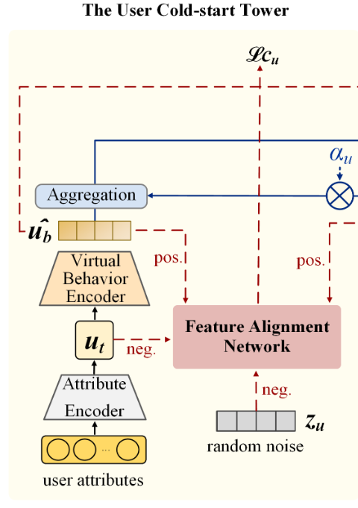
Construction of Attribute Features
user attributes ($A_{u}$) and user ID ( ${ID}_{u}$)
$A_{u}：$categories of his/her preferred news
,𝑇： topics, 𝑆：subtopics
virtual feature generation

Slide 14
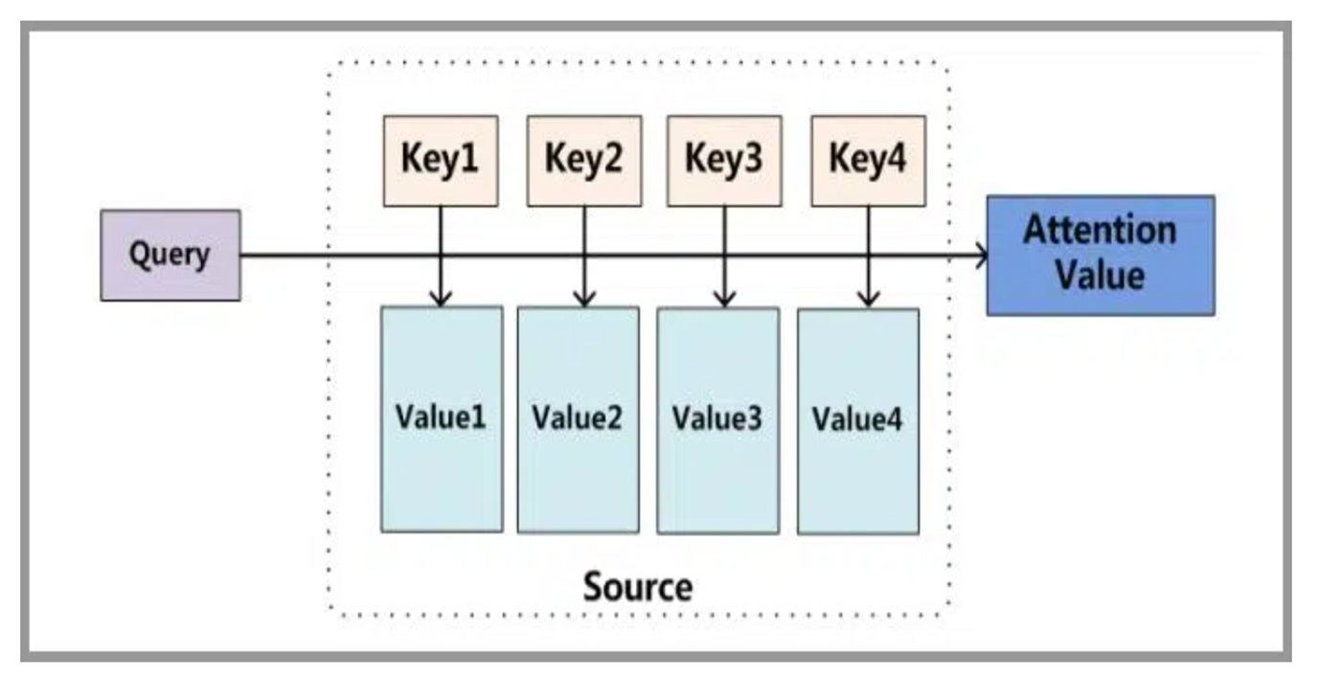
The Basic concepts of Attention Mechanism

Slide 15
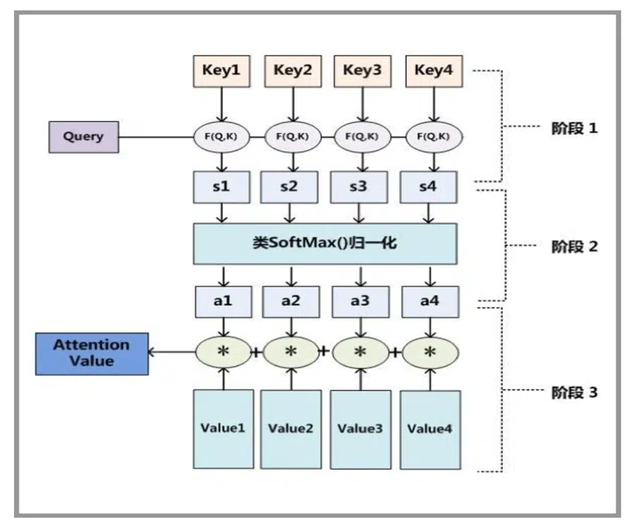
Three steps by Attention Mechanisms

Slide 16
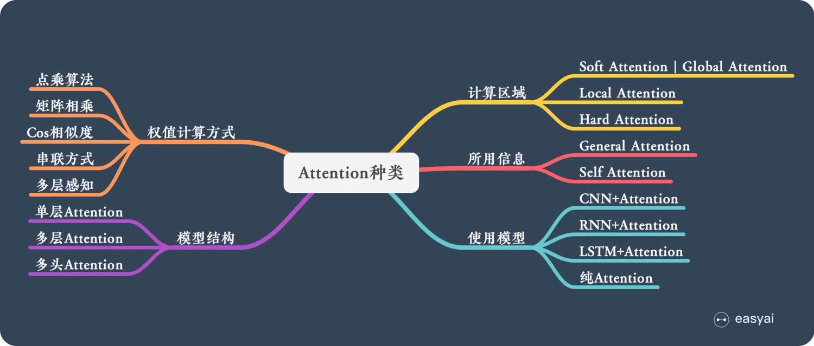
Attention種類
input：a user set 𝑈, item set 𝐼,
a set of time periods 𝐻 (each time period 𝑡 ∈ 𝐻)
output：recommended score $Y$
recommendation function：${\hat{y}}_{u, i}^{t}$= $f_{θ}^{t}$($X_{u}$, $X_{i}$)
${\hat{y}}_{u, i}^{t}$ ：recommended score for item 𝑖 assigned by user 𝑢 dur
$f_{θ}^{t}$：a neural network model, $X_{u}$：user features, $X_{i}$：item features

Slide 17
Methods for Getting Matching Scores (Query and Keys)
1）Inner product：
2）Matrix product (Inner product after transformation)：
3）Cosine Similarity：
4）Concat：
5）MLP：

Slide 18
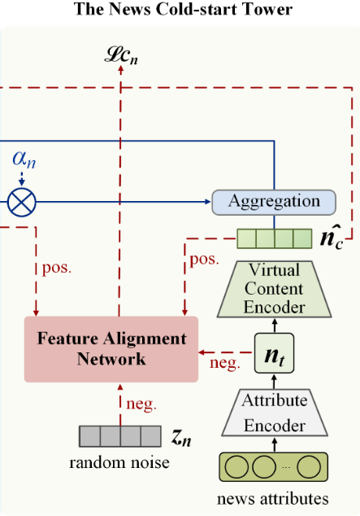
Construction of Attribute Features
news attributes ($A_{n}$) and news ID ( ${ID}_{n}$)
$A_{n}：$content features
𝑊：titles, 𝐸：entities, 𝑇：topics, 𝑆：subtopics
virtual feature generation

Slide 19
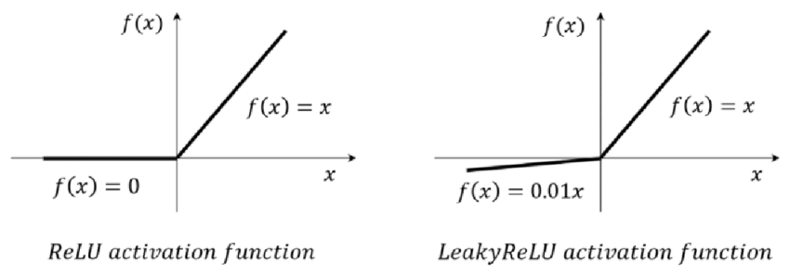
Virtual Representation
user
news

Slide 20
Content-oriented Feature Alignment
user
news

Slide 21
Task-oriented Feature Alignment

Slide 22
Overall Loss Function

Slide 23
Outline
Introduction
Method
Experiment
Conclusion

Slide 24
Data Set
news content and user click behavior information
recommendation scenarios

Slide 25
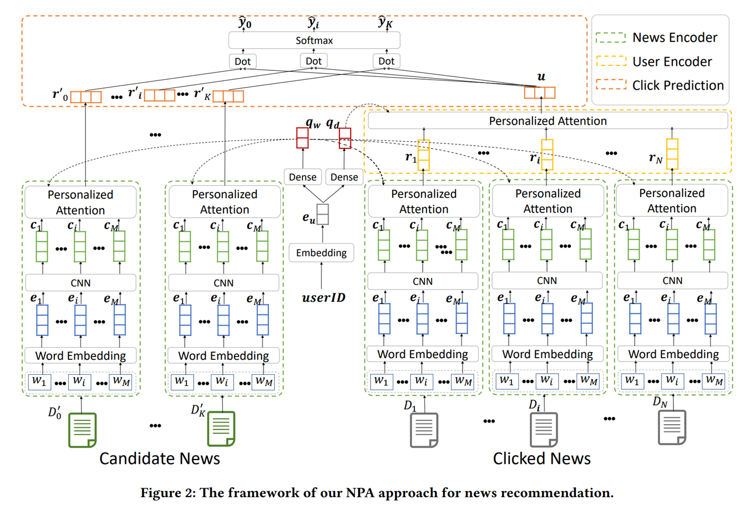
Baseline -- NPA
personalized attention mechanism to select important words and news articles according to user preferences

Slide 26
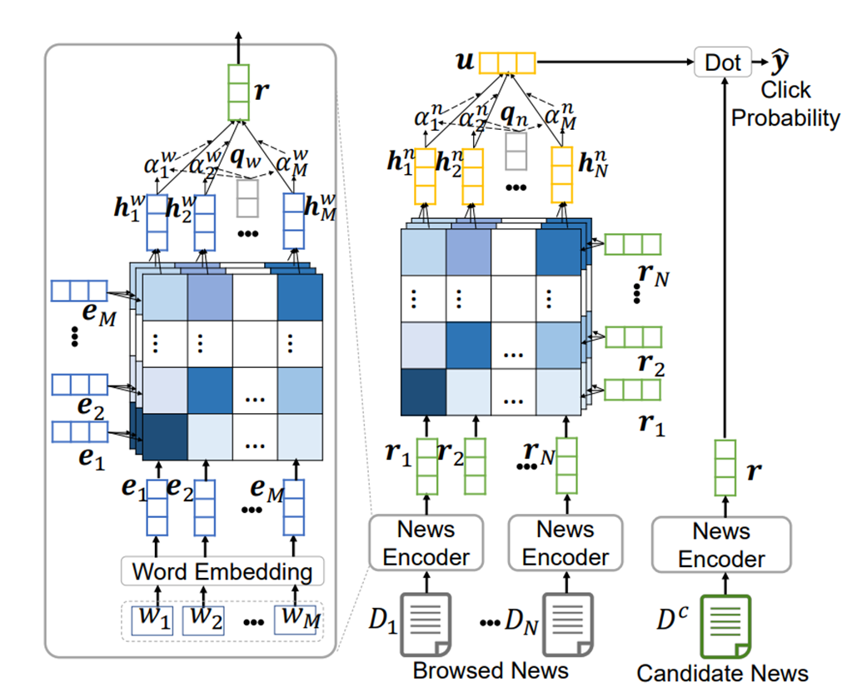
Baseline -- NRMS
multi-head self-attention mechanism in user and news encoders to capture interactions between words in news titles, and between news browsed by users

Slide 27
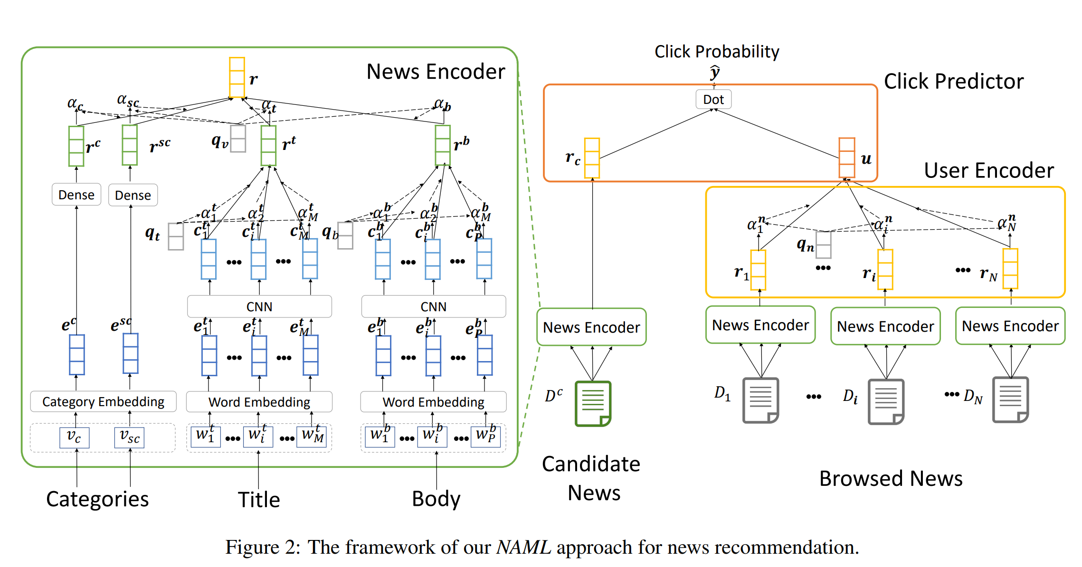
Baseline -- NAML
attentive multi-view learning to incorporate different kinds of news information such as titles, bodies and topic categories into the representations of news articles

Slide 28
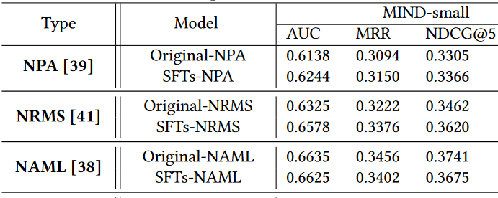
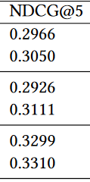
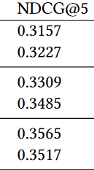
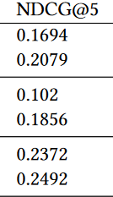
Experiment
WU
CU
WN
CN
personalized attention
multi-head self-attention
attentive multi-view learning

Slide 29
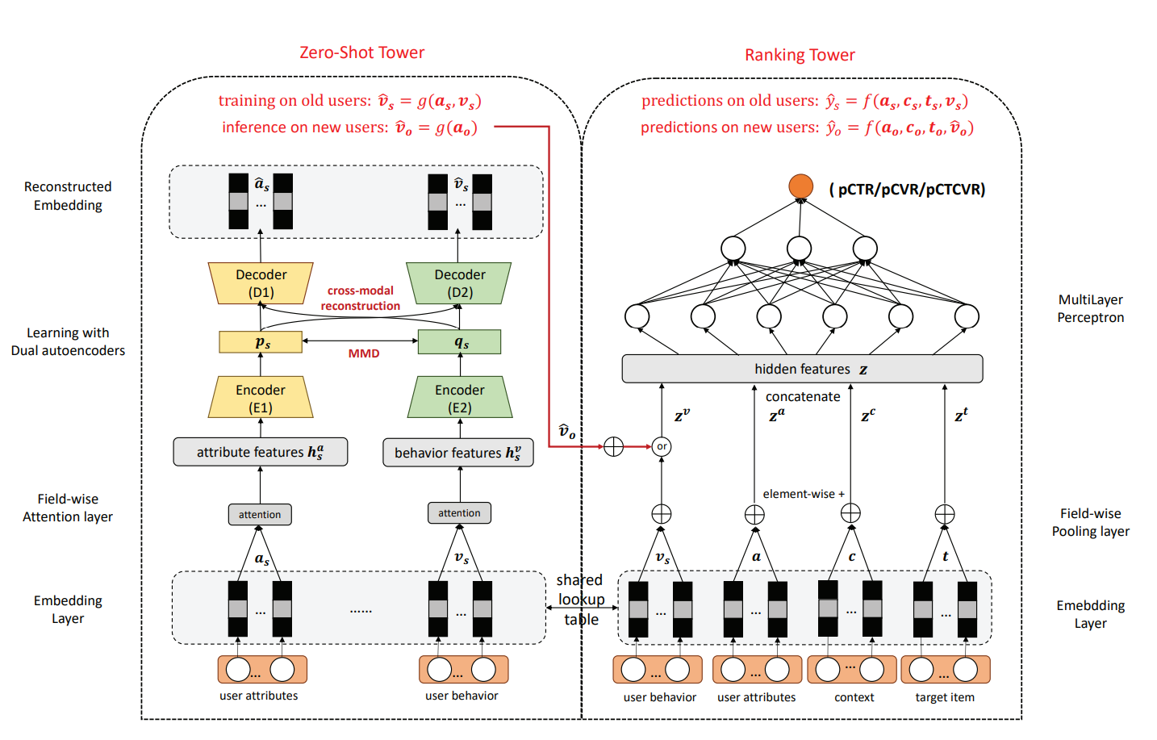
Baseline -- MAIL
AutoEncoder

Slide 30
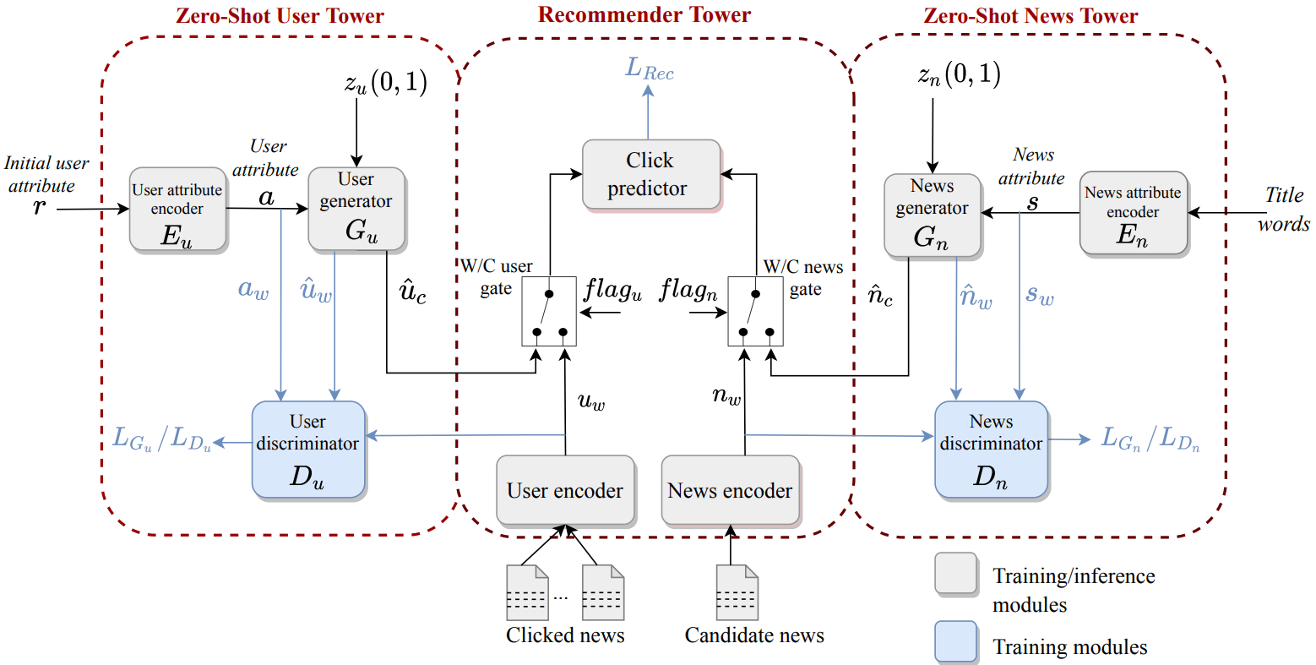
Baseline -- GAZRec
Generative Adversarial

Slide 31
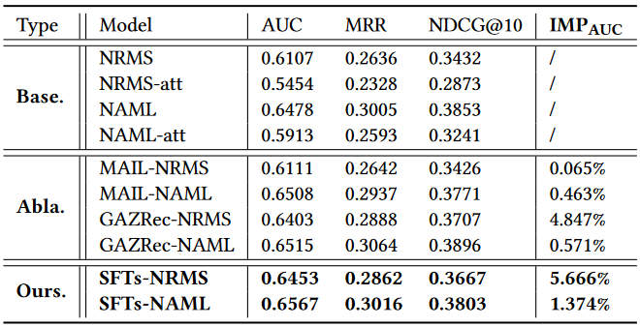
Ablation Experiments
AutoEncoder
Generative Adversarial

Slide 32
Outline
Introduction
Method
Experiment
Conclusion

Slide 33
Conclusion
a model-agnostic framework called SFCNR, which enhances recommendation performance in both user and news cold-start scenarios
content-oriented and task-oriented feature alignments ensure that virtual features align with the original distribution
a personalized gating mechanism to perform weighted fusion based on the quality of raw representation learning

Slide 34
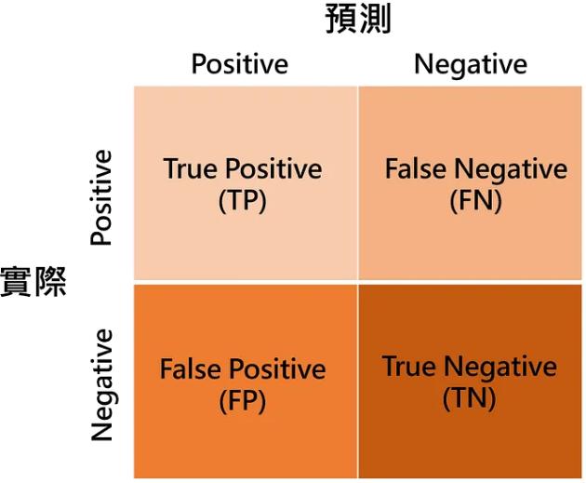
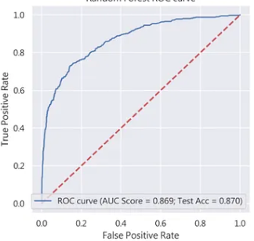
Evaluation Metrics – AUC
Area under the Curve of ROC
ROC

Slide 35
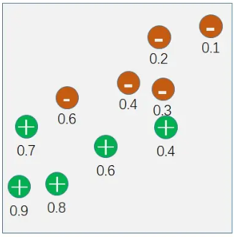
ROC

Slide 36
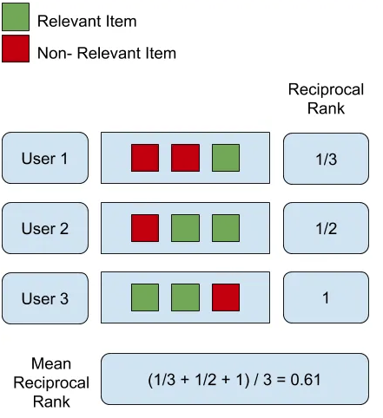
Evaluation Metrics – MRR
Mean Reciprocal Rank

Slide 37
Evaluation Metrics – NDCG
Normalized Discounted Cumulative Gain

